Slide 1
Consumer Behaviour Analysis
Visvanathan S
DS-S-WE-T-B37
WWW.SHOPEASY.COM

Slide 2
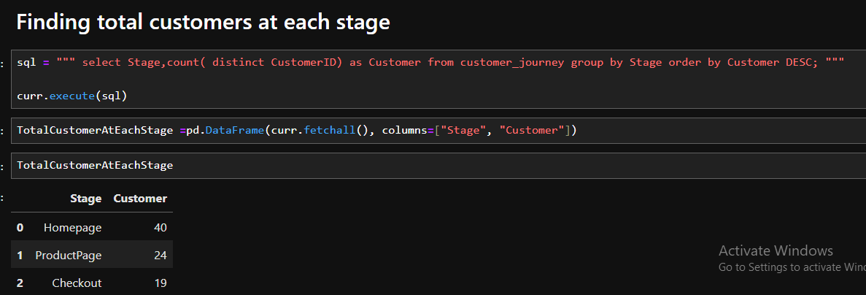
Finding total customers at each stage

Slide 3
Insights we get from the results
we can see there's a decline in Customer's purchase perspective as he/she tried to move from Homepage to Checkout Page

Slide 4
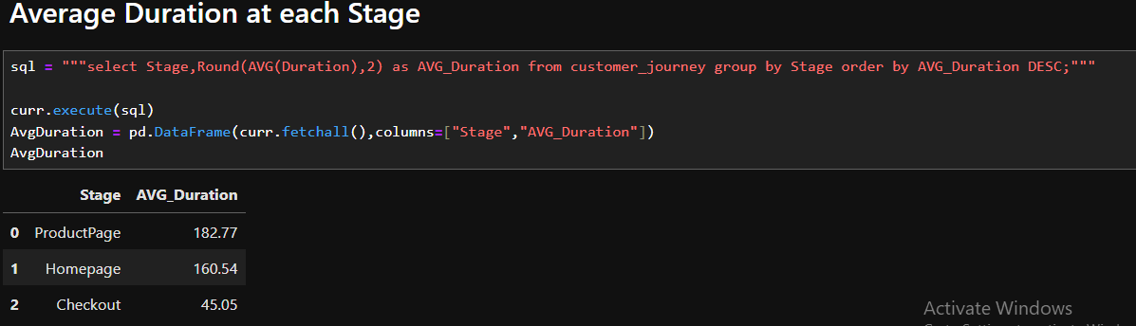
Average Duration at each Stage

Slide 5
Insights we get from the results
From the above results we can see customers are moving from HomePage to ProductPage and people are viewing the product but due to high price or product reviews the duration spent in checkout page is less because number of customers moving to checkout is less and people are dropping off at checkout page only, this may be due to page interaction or additional charges or misleading info displayed in Checkout page etc...

Slide 6
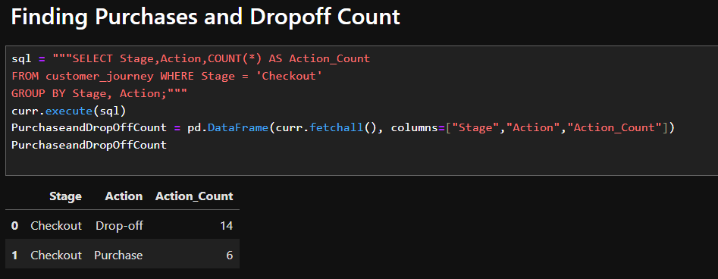
Finding Purchases and Drop off Count

Slide 7
Insights we get from the results
From the above results out of 20 people 14 dropped off at checkout and only 6 made a purchase that's 70% drop off at the checkout stage alone.
People are interested to buy the products but due to additional charges or misleading informations
or delayed delivery dates or delivery not available at their home location 70% of the people droped off their purchases.

Slide 8
Solution
Provide some discounts for regular customer, display messages like "Get 10% of on your 3rd purchase"
Increase Delivery Speed, try to provide free delivery for near by Locations.
Cancel additional fees like delivery fee if they have purchased more than a certain amount.
Increase the range of delivery to all locations
Make the checkout page more attractive, simple and easily understandable, avoid any misleading statements.

Slide 9
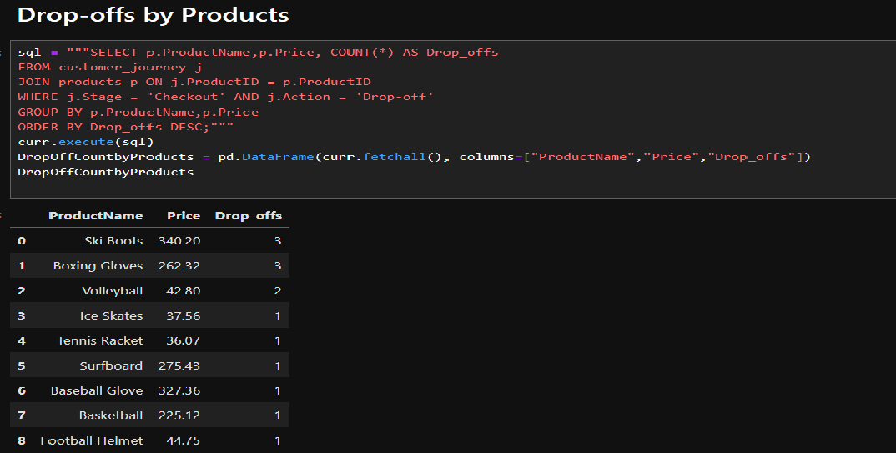
Drop-offs by Products

Slide 10
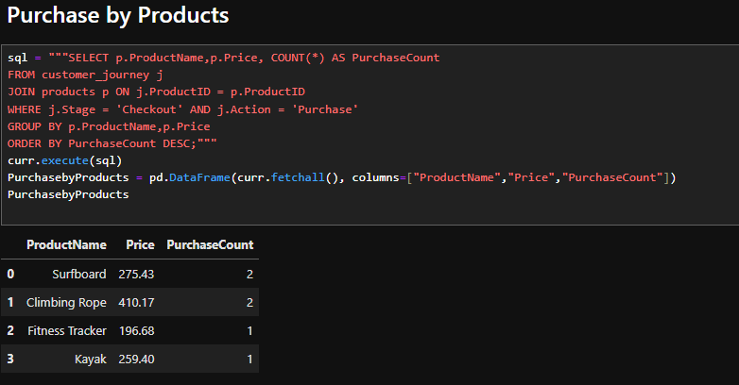
Purchase by Products

Slide 11
Insights we get from the results
Even high priced products are bought so price alone is not the conversion factor.
Low Priced Products are also Dropped off, We need to investigate Product Specifications, rating, additional Charges, Webpage UI/UX.
Surfboard and Climbing Rope have better conversion despite high price, focus on replicating their success factors(e.g.,marketing, product descriptions).

Slide 12
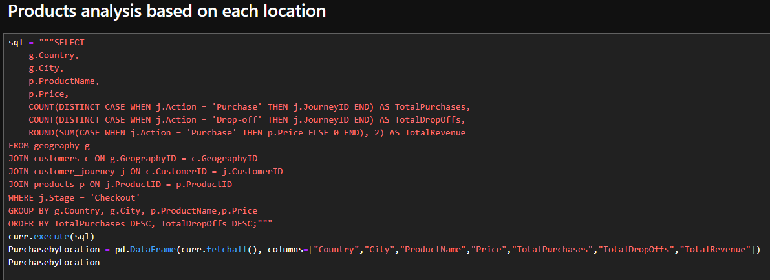
Products analysis based on each location

Slide 13
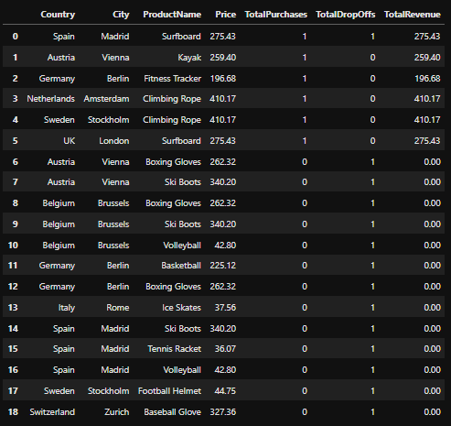
Results

Slide 14
Insights we get from the results
Even high priced products like Surfboard and Climbing Rope are bought so use those campaigning technique in other locations too.
Analyse the sports based on the locations geography and increase campaigns for those products, provide some deals/discounts too.

Slide 15
Customer Review Analysis

Slide 16
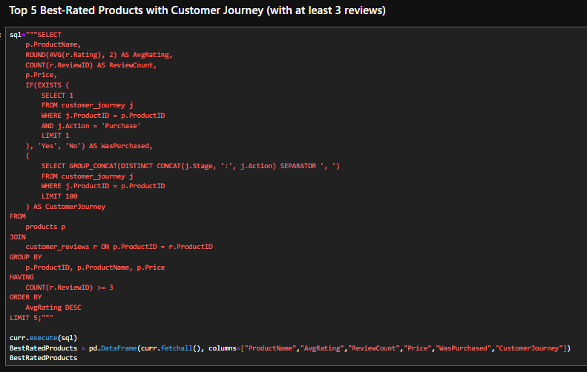
Top 5 Best-Rated Products with Customer Journey (with at least 3 reviews)

Slide 17
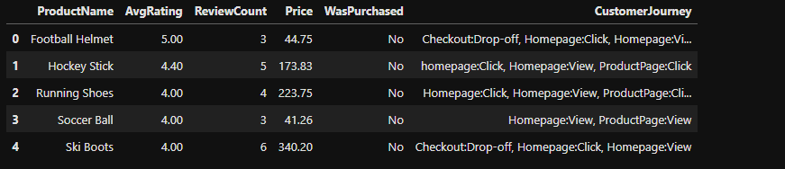
Results

Slide 18
Insights we get from the results
Customers are loving these products and they are wiling to buy it, but conversion didn't happen even though customers are interested.
They are giving more rating for the product quality, but according to my analysis demand for these products are more if we provide a discount the purchase rate for these products will increase.

Slide 19
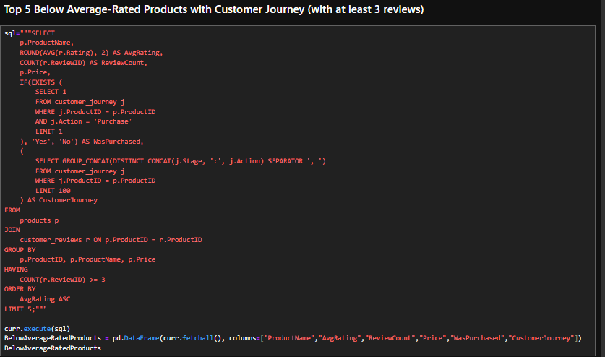
Top 5 Below Average-Rated Products with Customer Journey (with at least 3 reviews)

Slide 20
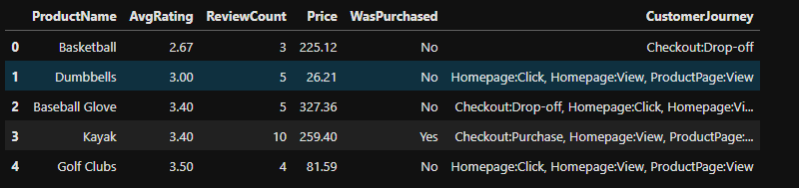
Results

Slide 21
Insights we get from the results
From the Top 5 Below Average rated products we can see customers are not satisfied with the product
because people stopped at product page, only few went to checkout page.
There maybe misleading information about the product or product price maybe high or the demand for the product is less
we can see there's one Purchase here, if we follow the same marketing methods on other products we can get more conversion rate for other products too

Slide 22
Market Analysis

Slide 23
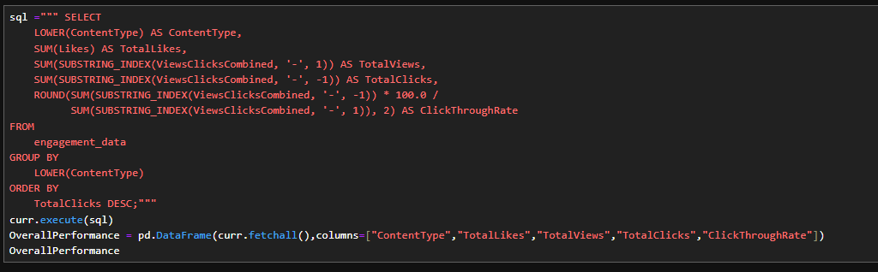
Overall Performance by Content Type

Slide 24
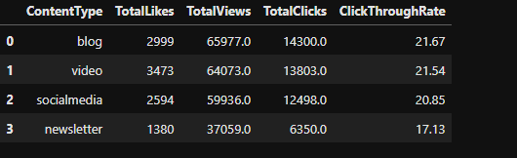
Results

Slide 25
Insights we get from the results
Blogs acts as a higher marketing platform, so we can post more product details and perform campaigns in blogs

Slide 26
Market Effectiveness

Slide 27
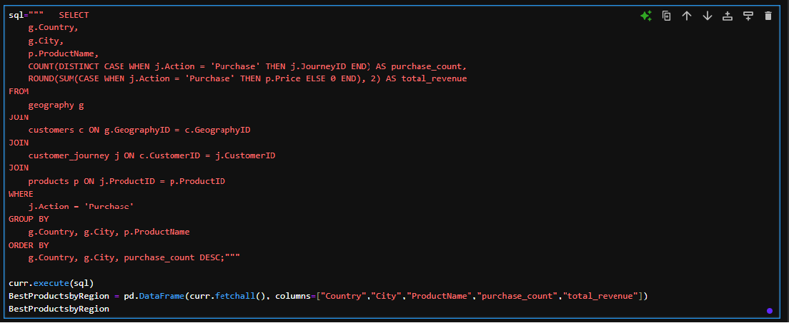
Best-Performing Products by Region

Slide 28
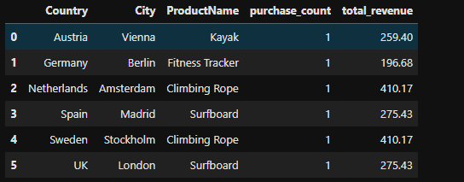
Results

Slide 29
Insights we get from the results
We can see the purchase count is only 1, we need to do valid/effective campaigns and provide some discounts on the products to increase the sales

Slide 30
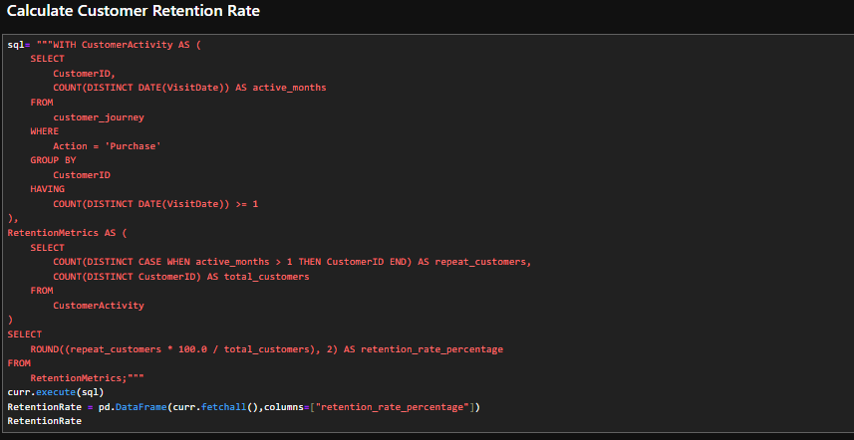
Calculate Customer Retention Rate

Slide 31
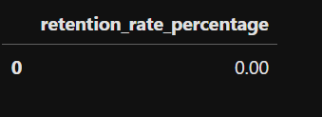
Results

Slide 32
Insights we get from the results
There's no repeat Customers, we need to attract the customers who previously bought a product by providing an offer saying "Get some discount at your 2nd or 3rd purchase".
We need to do more marketing and attract new buying customers

Slide 33
Recommendations on improving customer experience
Simplify the Checkout process for High-Drop-Off Products
Address Low-Rated Products, try to replace them with good quality and minimum priced products
Personalize Recommendations by Region
Send out Discount Emails to the customers who dropped off at checkout stage

Slide 34
Thankyou
VISVANATHAN S
WWW.SHOPEASY.COM

